Slide 1




RCB - IPL DATA ANALYSIS
Presented By - PAVAN C Y
06/03/2026

Slide 2


ABOUT PROJECT
This project focuses on analyzing Indian Premier League (IPL) cricket data using SQL to extract meaningful insights about team performance, player statistics, and match outcomes. The dataset contains detailed information about matches, players, teams, venues, and ball-by-ball match events.
Using SQL queries, various analyses were performed to understand patterns such as team success rates, player performance metrics, scoring trends, and the impact of match conditions like toss decisions and venues. The project also investigates the historical performance of Royal Challengers Bangalore (RCB) to identify factors affecting their results across seasons.
The goal of this project is to demonstrate how database querying techniques can be used for sports analytics and decision-making.

Slide 3
PROBLEM STATEMENT
The Indian Premier League (IPL) is one of the most popular and competitive T20 cricket leagues in the world. Each season generates a large amount of match data, including player performances, team statistics, venue conditions, and match outcomes. Analyzing this data can provide valuable insights into team strategies, player contributions, and factors that influence match results.
However, due to the large volume and complexity of IPL match data, it becomes difficult to manually analyze patterns related to team performance, player efficiency, scoring trends, and venue impact. Teams and analysts need a structured approach to process this data and extract meaningful information that can support strategic decision-making.
The main problem addressed in this project is to analyze IPL match data using SQL to uncover patterns and insights related to player performance, team success, venue conditions, and match outcomes. The project focuses on using structured query language (SQL) to process and analyze multiple relational tables containing detailed ball-by-ball match data, player information, match results, and venue details.
Another important aspect of this analysis is to evaluate the performance of specific teams, particularly Royal Challengers Bangalore (RCB), in order to understand potential reasons behind their inconsistent performance across seasons. By examining factors such as batting dependency, bowling economy rates, and win percentages, the analysis attempts to identify strengths and weaknesses within the team structure.
The project also investigates key match factors such as toss decisions, home-ground advantage, and venue-based scoring patterns, which may influence match results and team strategies. Understanding these factors can help teams optimize their gameplay strategies, player selection, and match planning.
Overall, the problem this project aims to solve is how to efficiently analyze large-scale IPL cricket data using SQL queries to generate actionable insights about teams, players, and match conditions, ultimately helping teams improve performance and make data-driven decisions.

Slide 4
PROJECT OBJECTIVES
To analyze the IPL dataset using SQL in order to extract meaningful insights related to matches, teams, and player performance.
To evaluate team performance across different IPL seasons by analyzing match results, win percentages, and seasonal trends.
To analyze player performance metrics such as total runs, strike rate, wickets taken, and economy rate to identify top-performing players.
To identify all-round players who contribute effectively with both batting and bowling, helping teams maintain balance in their squad.
To study the impact of toss decisions on match outcomes and understand whether choosing to bat or field first influences winning chances.
To analyze venue-based match performance to determine which stadiums produce high-scoring matches and how venue conditions affect gameplay.
To evaluate the home-ground advantage for teams, particularly Royal Challengers Bangalore (RCB), and analyze how performance changes at home venues compared to other venues.
To investigate team dependencies on key players, especially identifying situations where teams rely heavily on a few top performers.
To analyze RCB’s historical performance across IPL seasons and identify potential reasons behind their inconsistent results.
To generate data-driven insights that can help teams improve strategies, player selection, and match planning in future tournaments.

Slide 5
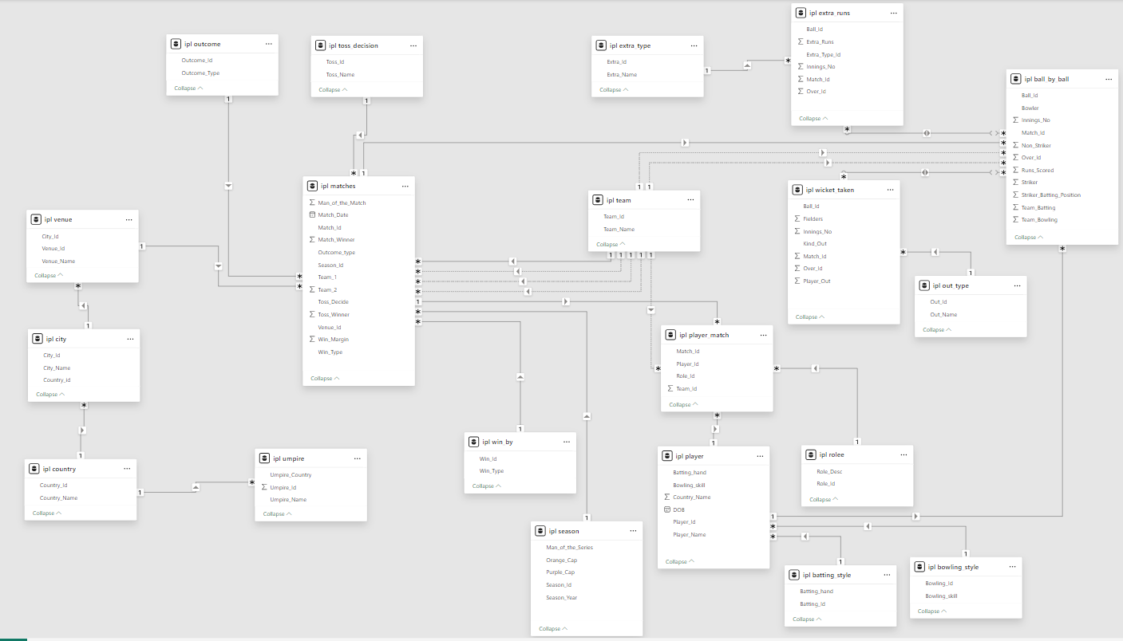
DATABASE SCHEMA

Slide 6
DATASET OVERVIEW
BALL BY BALL
MATCH_ID: UNIQUE IDENTIFIER FOR A CRICKET MATCH
OVER_ID: UNIQUE IDENTIFIER FOR AN OVER IN A CRICKET MATCH
BALL_ID: UNIQUE IDENTIFIER FOR A BALL IN AN OVER
INNINGS_NO: THE INNINGS NUMBER IN A CRICKET MATCH
TEAM_BATTING: THE TEAM BATTING IN A PARTICULAR INNINGS
TEAM_BOWLING: THE TEAM BOWLING IN A PARTICULAR INNINGS
STRIKER_BATTING_POSITION: THE BATTING POSITION OF THE STRIKER BATSMAN
STRIKER: THE BATSMAN CURRENTLY ON STRIKE
NON_STRIKER: THE BATSMAN CURRENTLY AT THE NON-STRIKER'S END
BOWLER: THE BOWLER BOWLING THE CURRENT DELIVERY
BATTING STYLE
BATTING_ID: UNIQUE IDENTIFIER FOR A BATSMAN'S BATTING RECORD
BATTING_HAND: THE BATTING HAND (RIGHT OR LEFT) OF A BATSMAN
BOWLING STYLE
BOWLING_ID: UNIQUE IDENTIFIER FOR A BOWLER'S BOWLING RECORD
BOWLING_SKILL: THE BOWLING SKILL (E.G., RIGHT-ARM FAST, LEFT-ARM SPIN) OF A BOWLER
CITY
CITY_ID: UNIQUE IDENTIFIER FOR A CITY
CITY_NAME: THE NAME OF A CITY
COUNTRY_ID: UNIQUE IDENTIFIER FOR A COUNTRY

Slide 7
MATCHES
MATCH_ID: UNIQUE IDENTIFIER FOR EACH MATCH.
MATCH_DATE: THE DATE WHEN THE MATCH TOOK PLACE.
MATCH_WINNER: THE TEAM THAT WON THE MATCH.
OUTCOME_TYPE: TYPE OF RESULT (WIN, TIE, ETC.).
TOSS_WINNER: THE TEAM THAT WON THE TOSS.
WIN_TYPE: THE METHOD BY WHICH THE MATCH WAS WON (E.G., RUNS OR WICKETS).
WIN_MARGIN: THE MARGIN BY WHICH THE MATCH WAS WON.
VENUE_ID: REFERENCE TO THE VENUE WHERE THE MATCH WAS PLAYED.
SEASON_ID: THE SEASON IN WHICH THE MATCH OCCURRED.
VENUE
VENUE_ID: UNIQUE IDENTIFIER FOR EACH VENUE.
VENUE_NAME: NAME OF THE VENUE.
CITY_ID: REFERENCE TO THE CITY WHERE THE VENUE IS LOCATED.
CouNTRY
COUNTRY_ID: UNIQUE IDENTIFIER FOR EACH COUNTRY.
COUNTRY_NAME: NAME OF THE COUNTRY.
PLAYER MATCH
MATCH_ID: REFERENCE TO THE MATCH IN WHICH THE PLAYER PARTICIPATED.
PLAYER_ID: REFERENCE TO THE PLAYER.
ROLE_ID: ROLE OF THE PLAYER (E.G., BATSMAN, BOWLER).
TEAM_ID: TEAM THAT THE PLAYER REPRESENTED IN THE MATCH.
WICKETS TAKEN
BALL_ID: REFERENCE TO THE SPECIFIC BALL DURING WHICH THE WICKET WAS TAKEN.
FIELDER: REFERENCE TO THE PLAYER WHO FIELDED THE BALL.
BOWLER: REFERENCE TO THE BOWLER WHO TOOK THE WICKET.
PLAYER_OUT: REFERENCE TO THE PLAYER WHO WAS DISMISSED.

Slide 8
EXTRA TYPE
EXTRA_TYPE_ID: UNIQUE IDENTIFIER FOR THE TYPE OF EXTRA RUNS SCORED IN A CRICKET MATCH.
EXTRA_RUNS: THE NUMBER OF EXTRA RUNS SCORED IN A PARTICULAR DELIVERY.
INNINGS_NO: THE INNINGS NUMBER IN A CRICKET MATCH.
EXTRA_ID: UNIQUE IDENTIFIER FOR AN INSTANCE OF EXTRA RUNS SCORED.
EXTRA_NAME: THE NAME OR DESCRIPTION OF THE TYPE OF EXTRA RUNS SCORED (E.G., BYES, LEG BYES, WIDES, NO-BALLS).
SEASON
SEASON_ID: UNIQUE IDENTIFIER FOR A PARTICULAR SEASON OR TOURNAMENT.
VENUE_ID: UNIQUE IDENTIFIER FOR THE VENUE OR STADIUM WHERE THE MATCH IS PLAYED.
Win_By
Win_Type: The type of win (e.g., runs, wickets) achieved by the winning team.
WIN_MARGIN: THE MARGIN OF VICTORY (E.G., RUNS OR WICKETS) FOR THE WINNING TEAM.
TEAM
TEAM_ID: UNIQUE IDENTIFIER FOR A TEAM.
TEAM_NAME: THE NAME OF A TEAM
OUT_TYPE
OUT_ID: UNIQUE IDENTIFIER FOR THE TYPE OF DISMISSAL OR WAY A BATSMAN GOT OUT.
OUT_NAME: THE NAME OR DESCRIPTION OF THE TYPE OF DISMISSAL (E.G., CAUGHT, BOWLED, LBW, RUN OUT).
OUTCOME_ID: UNIQUE IDENTIFIER FOR THE OUTCOME OR RESULT OF A MATCH.

Slide 9
OUTCOME
Outcome_type: The type of outcome or result of the match (e.g., win, loss, tie, no result).
Match_Winner: The team that won the match.
Man_of_the_Match: The player awarded the Man of the Match award.
ROLEE
ROLE_ID: UNIQUE IDENTIFIER FOR A PLAYER'S ROLE OR SKILLS (E.G., BATSMAN, BOWLER, ALL-ROUNDER).
ROLE_DESC: DESCRIPTION OF A PLAYER'S ROLE OR SKILLS.
MAN_OF_THE_SERIES: THE PLAYER AWARDED THE MAN OF THE SERIES AWARD FOR A PARTICULAR TOURNAMENT.
ORANGE_CAP: THE PLAYER AWARDED THE ORANGE CAP (FOR MOST RUNS SCORED) IN A PARTICULAR TOURNAMENT.
PURPLE_CAP: THE PLAYER AWARDED THE PURPLE CAP (FOR MOST WICKETS TAKEN) IN A PARTICULAR TOURNAMENT.
UMPIRE
UMPIRE_ID: UNIQUE IDENTIFIER FOR AN UMPIRE OFFICIATING THE MATCH.
UMPIRE_NAME: THE NAME OF AN UMPIRE.
UMPIRE_COUNTRY: THE COUNTRY OR NATIONALITY OF AN UMPIRE.
TOSS DECISION
TOSS_NAME: THE NAME OR DESCRIPTION OF THE TOSS (E.G., HEADS OR TAILS).
PLAYER
PLAYER_ID: UNIQUE IDENTIFIER FOR A PLAYER.
PLAYER_NAME: THE NAME OF A PLAYER.

Slide 10
METHODOLOGY
The methodology of this project involves analyzing IPL match data using SQL to extract meaningful insights about team performance, player statistics, and match outcomes.
1. Data Collection :
The IPL dataset containing information about matches, players, teams, venues, and ball-by-ball events was collected. The data was organized into multiple relational tables such as Matches, Ball_by_Ball, Player, Player_Match, Venue, Season, and Wicket_Taken.
2. Database Setup :
The dataset was imported into MySQL Workbench, where a database was created and tables were defined using SQL queries. Relationships between tables were established using primary keys and foreign keys.
3. Data Exploration :
Initial SQL queries were executed to understand the structure of the dataset and explore basic information such as total matches, players, runs scored, and wickets taken.
4. Data Analysis :
SQL queries were written to analyze different aspects of IPL performance, including:
Player batting and bowling performance
Team performance across seasons
Impact of toss decisions
Venue-based scoring patterns
Home-ground advantage

Slide 11

5. Visualization :
The results of the SQL queries were visualized using Excel / Google Sheets charts to better understand patterns and trends in the data.
6. Insight Generation :
Based on the analysis and visualizations, key insights were generated regarding team strategies, player contributions, and factors affecting match outcomes.

Slide 12

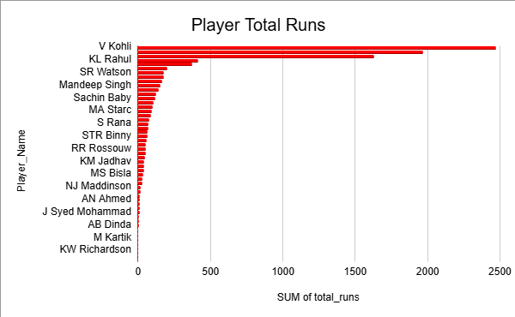
PLAYER PERFORMANCE ANALYSIS
Top Run Scorers Analysis:
This analysis evaluates the batting performance of players based on the total runs scored across matches. The chart displays the contribution of each player in terms of total runs, helping identify the most consistent and impactful batsmen.
From the visualization, it can be observed that Virat Kohli and KL Rahul have scored significantly more runs compared to other players, making them the major contributors to the team’s batting performance. Other players such as SR Watson and Mandeep Singh also contribute runs but at a comparatively lower level.
This analysis highlights the dependency of the team on a few key batsmen for scoring runs. Such insights help teams understand player contributions and make better decisions related to batting order, player selection, and team strategy.

Slide 13
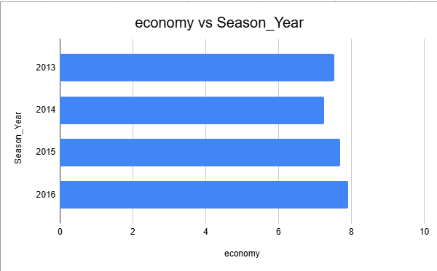
RCB BOWLING PERFORMANCE ANALYSIS
bowling economy rate of RCB :
This analysis examines the bowling economy rate of Royal Challengers Bangalore (RCB) across different IPL seasons. The economy rate measures how many runs a team’s bowlers concede per over, which is an important indicator of bowling efficiency.
From the visualization, it can be observed that the economy rate remains relatively high across multiple seasons, indicating that RCB bowlers often concede a significant number of runs. A higher economy rate suggests that the bowling unit struggles to restrict the opposition’s scoring rate.
This pattern highlights one of the major challenges faced by RCB in several seasons. Even though the team has strong batting performances, conceding more runs puts additional pressure on the batting lineup during run chases.
Improving bowling strategies, selecting economical bowlers, and strengthening the bowling attack can help the team achieve better overall performance in future seasons.

Slide 14
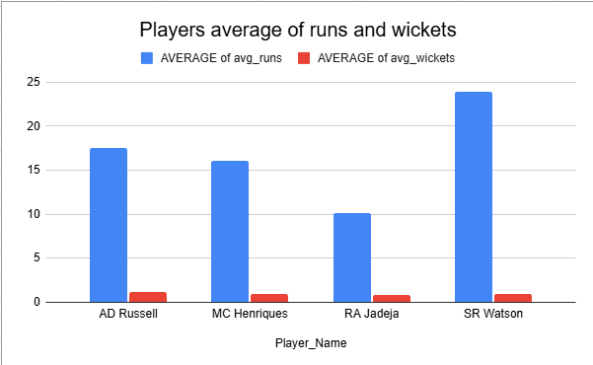
ALL-ROUNDER PERFORMANCE ANALYSIS
Players Contributing with Both Bat and Ball :
This analysis focuses on identifying players who contribute effectively with both batting and bowling, commonly known as all-rounders. These players are highly valuable because they provide balance to the team by supporting both departments of the game.
The visualization compares average runs scored and average wickets taken by players. From the chart, players such as SR Watson and AD Russell demonstrate strong all-round capabilities, as they contribute significantly in both batting and bowling. Other players also show balanced contributions, indicating their ability to support the team in multiple roles.
Identifying such versatile players is important for building a strong and flexible team lineup. All-rounders help teams maintain stability during matches and improve overall team performance by contributing in different aspects of the game.

Slide 15
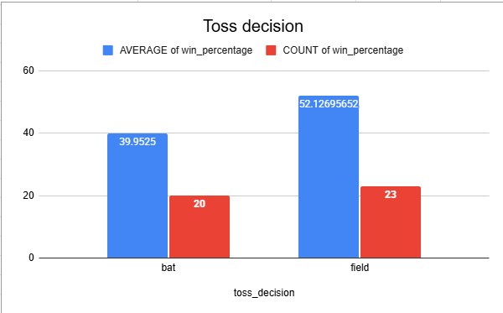
TOSS DECISION ANALYSIS
Effect of Toss Decision on Match Results :
This analysis examines how the toss decision influences the outcome of matches. In cricket, winning the toss allows a team to choose whether to bat first or field first, depending on pitch conditions, weather, and match strategy.
The visualization compares the win percentage of teams that choose to bat first and teams that choose to field first after winning the toss. The results indicate that teams choosing to field first tend to have a slightly higher win percentage compared to those choosing to bat first.
This pattern suggests that chasing a target may provide a strategic advantage in many IPL matches. Factors such as dew conditions, better understanding of the target score, and pitch behavior later in the match may contribute to this advantage.
Understanding the impact of toss decisions helps teams develop better match strategies and tactical planning.

Slide 16
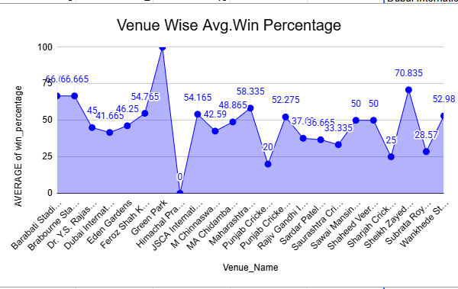
VENUE ANALYSIS
Venue-wise Scoring Patterns :
This analysis examines how team performance varies across different venues by comparing the average win percentage at each stadium. Different venues have unique characteristics such as pitch conditions, boundary dimensions, weather conditions, and crowd influence, which can significantly impact match outcomes.
The visualization shows the average win percentage across various venues, helping identify locations where teams tend to perform better. Some venues show higher win percentages, suggesting that teams may have a competitive advantage due to familiarity with the ground conditions or favorable pitch behavior.
Understanding venue-based performance patterns allows teams to develop venue-specific strategies, such as selecting suitable players, adjusting batting or bowling tactics, and optimizing match planning based on the conditions of the stadium.
This analysis helps teams make data-driven decisions to improve performance at different venues.

Slide 17
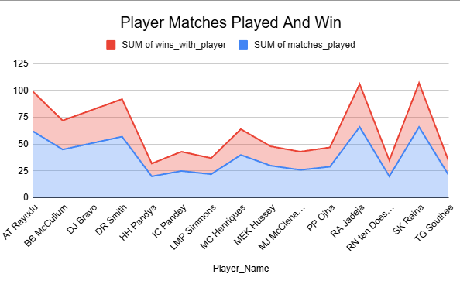
TEAM PLAYER ANALYSIS
Player Impact on Team Performance :
This analysis examines how the presence of certain players influences the team’s match outcomes. The chart compares the total number of matches played by each player with the number of matches won when that player was part of the team.
From the visualization, it can be observed that some players have a higher number of team wins relative to the matches they played. This suggests that these players may have a positive impact on overall team performance. Players such as RA Jadeja, SK Raina, and AT Rayudu show strong contributions when they are part of the playing lineup.
These players may contribute through consistent performance, leadership, experience, and the ability to perform under pressure. Identifying such influential players helps teams make better decisions related to player retention, team selection, and match strategies.
This analysis highlights the importance of selecting players who not only perform individually but also positively influence the overall success of the team.

Slide 18
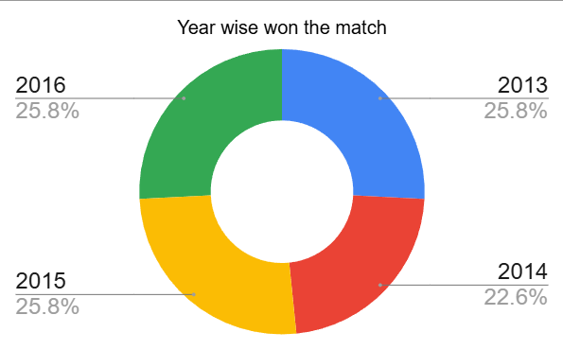
SEASON-WISE WINS ANALYSIS
Season-wise Match Wins Analysis :
This analysis examines the distribution of matches won by the team across different IPL seasons. The visualization shows the percentage of matches won in each season, helping to understand the team’s performance trends over time.
From the chart, it can be observed that the team’s wins are relatively distributed across multiple seasons, with most seasons showing a similar percentage of victories. However, slight variations in win percentages indicate that the team’s performance has not been consistently dominant in any particular season.
This pattern suggests that while the team has remained competitive across seasons, maintaining consistent winning momentum has been a challenge. Understanding these seasonal performance trends helps identify areas where improvements in team strategy, player selection, and overall performance consistency may be required to achieve better results in future tournaments.

Slide 19
KEY INSIGHTS
The analysis of IPL match data using SQL provided several important insights about team and player performance.
The study revealed that a few top players contribute a large portion of the total runs, indicating a strong dependency on key batsmen. This suggests that teams may need to strengthen their middle order to maintain consistent performance.
The bowling analysis showed that higher economy rates can negatively impact match outcomes, as conceding more runs puts additional pressure on the batting lineup.
Venue-based analysis highlighted that different stadiums influence scoring patterns and match results, which means teams should adopt venue-specific strategies.
The analysis also identified all-round players who contribute effectively with both bat and ball, making them valuable assets for team balance.
Overall, the insights demonstrate how data-driven analysis can help teams improve decision-making, player selection, and match strategies

Slide 20
STRATEGIC RECOMMENDATIONS
Based on the comprehensive analysis of IPL match data, several strategic recommendations can be proposed to improve overall team performance and competitiveness.
Teams should focus on building a balanced squad rather than relying heavily on a few star players. The analysis shows that teams often depend on a small number of top batsmen for the majority of runs. To reduce this dependency, teams should strengthen their middle-order batting lineup so that the team can maintain stability even if top-order players fail.
Teams should improve bowling efficiency, especially in controlling the run rate during crucial phases of the match such as the middle overs and death overs. The economy rate analysis indicates that conceding too many runs increases pressure on the batting lineup. Therefore, teams should prioritize selecting bowlers who maintain low economy rates and possess strong variation skills such as yorkers, slower balls, and cutters.
Teams should strategically select multi-skilled all-round players who can contribute with both batting and bowling. All-rounders increase team flexibility by providing additional bowling options and strengthening the batting depth. This helps teams adapt to different match situations and improve overall balance.
Teams should adopt venue-specific strategies based on pitch conditions and historical scoring patterns. Some venues favor batting due to flat pitches and shorter boundaries, while others support bowlers. By analyzing venue data, teams can choose players whose skills match the conditions of each stadium.
Teams should develop a data-driven approach to decision-making, using historical match data, player performance statistics, and venue analysis to guide strategies such as batting order decisions, bowling changes, and player selection.
Teams should focus on long-term team development and performance consistency by identifying emerging talent, maintaining a stable core group of players, and continuously analyzing performance trends. Implementing these strategies can significantly improve team competitiveness and increase the chances of success in future IPL seasons.

Slide 21
CONCLUSION
This project focused on analyzing IPL match data using SQL in order to extract meaningful insights related to team performance, player contributions, match strategies, and venue influence. By using structured queries and data analysis techniques, raw cricket data was transformed into valuable information that helps understand different aspects of the game.
The analysis highlighted several important patterns. Player performance evaluation showed that a small group of top players contributes a significant portion of total runs, indicating that teams often depend heavily on key batsmen. Identifying such performance trends helps teams understand the importance of maintaining a balanced batting lineup with strong middle-order support.
The bowling analysis revealed that economy rate plays a crucial role in determining match outcomes. Teams that struggle to control the opposition’s scoring rate often face additional pressure on their batting units. Strengthening the bowling attack and improving bowling strategies can significantly enhance overall team performance.
Venue analysis demonstrated that different stadiums influence scoring patterns and match results due to variations in pitch conditions, ground dimensions, and environmental factors. Understanding these venue characteristics allows teams to adapt their strategies and select players suited to specific playing conditions.
The project also emphasized the importance of all-round players and versatile team members who can contribute effectively in both batting and bowling. Such players improve team flexibility and provide greater strategic options during matches.
Overall, this project demonstrates how data analysis using SQL can provide valuable insights for sports analytics. By applying data-driven approaches, teams can make more informed decisions related to player selection, match strategy, and long-term team development. These analytical insights can ultimately help teams improve their performance and increase their chances of achieving success in competitive tournaments like the IPL.

Slide 22
THANK
YOU

